Slide 1
Salary and Compensation Analysis Through Excel Data Modeling
Student Name:Naveen Kumar. R
Register Number:312211650
Department:BCOM general A
College: Thiruthangal nadar college

Slide 2
PROJECT TITLE :
Salary and Compensation Analysis Through Excel Data Modeling

Slide 3
AGENDA :
Problem Statement
Project Overview
End Users
Our Solution and Proposition
Dataset Description
Modelling Approach
Results and Discussion
Conclusion

Slide 4
PROBLEM STATEMENT :
Title: “Optimizing Salary and Compensation Structures” Description: Explain the challenges of ensuring fair and competitive salaries, and the need for data-driven analysis.

Slide 5
PROJECT OVERVIEW :
Title: “Salary and Compensation Analysis Project” Description: Outline the project’s objectives, scope, and timeline.

Slide 6
End users
Title: “Data-Driven Salary and Compensation Insights” Description: Explain how data modeling in Excel can help analyze and optimize salary and compensation structures.

Slide 7
OUR SOLUTION AND ITS VALUE PROPOSITION :
Title: “Data-Driven Salary and Compensation Insights” Description: Explain how data modeling in Excel can help analyze and optimize salary and compensation structures

Slide 8
Dataset Description:
Title: “Compensation Data Overview” Description: Describe the data used for analysis, including: Data sources (HR systems, surveys, market data) – Variables (salary, bonuses, benefits, job titles, departments, etc.) – Data quality and preprocessing steps

Slide 9
Modelling Approach:
Title: “Compensation Data Modeling” Description: Outline the modeling approach, including: - Data visualization (charts, tables) – Statistical analysis (regression, correlation) - Data mining (clustering, decision trees) - Model evaluation metrics (accuracy, precision, recall, etc.)

Slide 10
RESULTS:
Table:
Classics | $18,580 | $49,225 | $16,326 | $10,017 | $26,134
Mystery | $78,970 | $82,262 | $48,640 | $49,985 | $73,428
Romance | $24,236 | $131,390 | $79,022 | $71,009 | $81,474
Sci-Fi & Fantasy | $16,730 | $19,730 | $12,109 | $11,355 | $17,686
Young Adult | $35,358 | $42,685 | $20,893 | $16,065 | $21,388

Slide 11
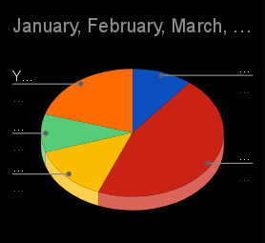
Pie chart:

Slide 12
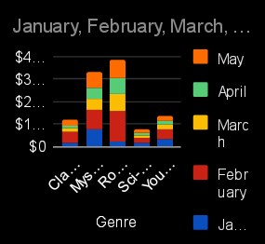
Par chart :

Slide 13
Conclusion:
Title: “Conclusion and Recommendations” Description: Summarize key findings, implications, and recommendations for optimizing salary and compensation structures.

